Slide 1

INDUCTOR DESIGN 1MHZ/5A AND SIMULATION IN BOOST CONVERTER
Hashem Jarhi, Amir Rashed
Advisor: Eric Herbelin

Slide 2
Introduction:
Designing Inductor to work in 1mhz/5A in FEMM software
Simulating the inductor in boost converter using Ltspice tool

Slide 3
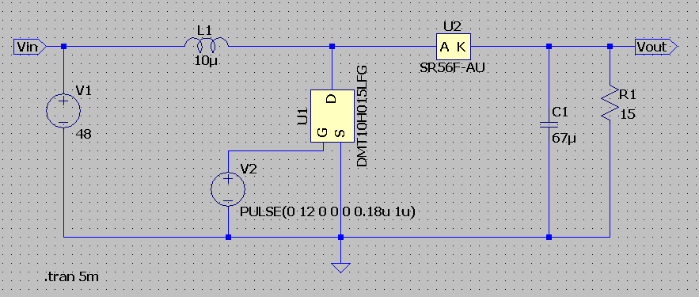
An ideal inductor
Vin = 48V
Vout = 60V
Frequency = 1 MHz
Idc (continuous) = 5A
Ipeak = 10A

Slide 4
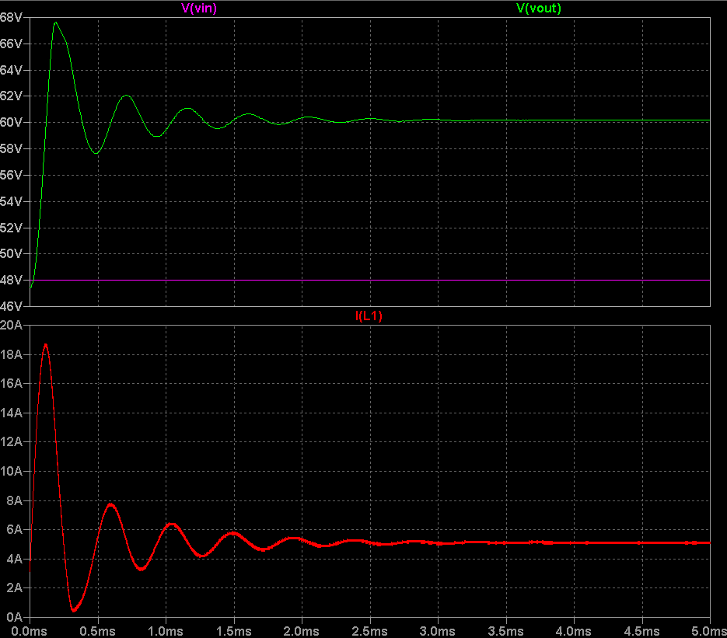
INDUCTOR SELECTION
Case 1: Inductance selected 48uH

Slide 5
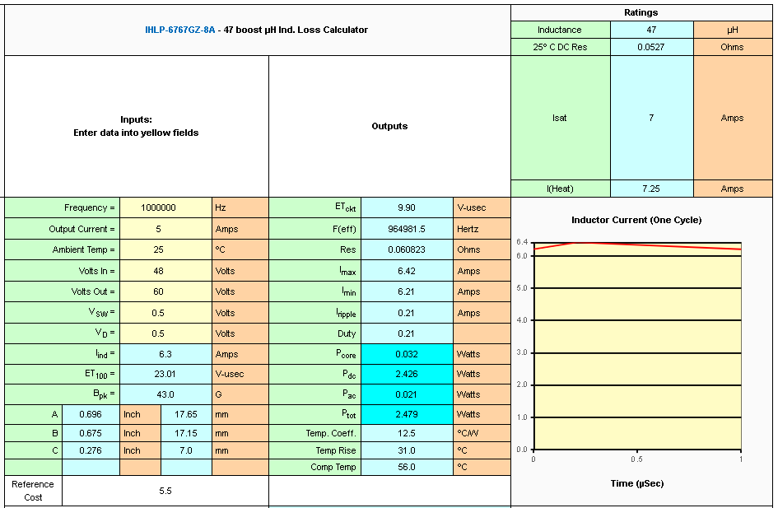
INDUCTOR SELECTION

Slide 6
INDUCTOR SELECTION
Case 1: Inductance selected 48uH
Pros:
Ripple in inductor less
Peak current requirement less
Cons:
More time to take for reaching at steady state level
More noise
More transient time
More Power loss in inductor
Efficiency affected

Slide 7
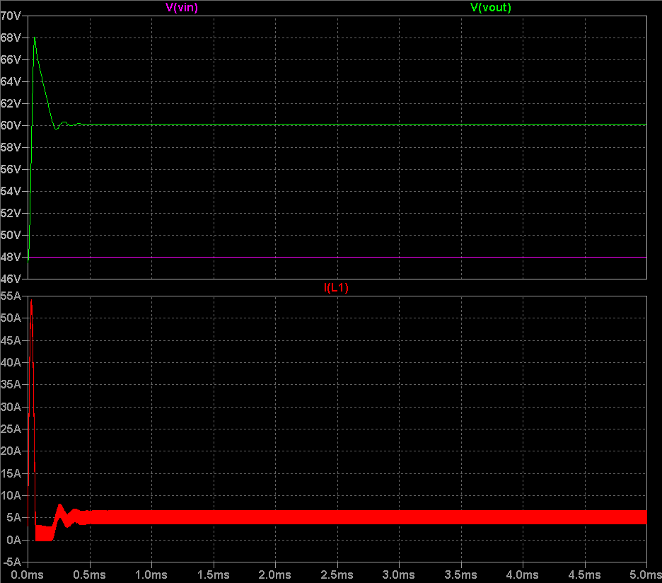
INDUCTOR SELECTION
Case 2: Inductance selected 3.3uH

Slide 8
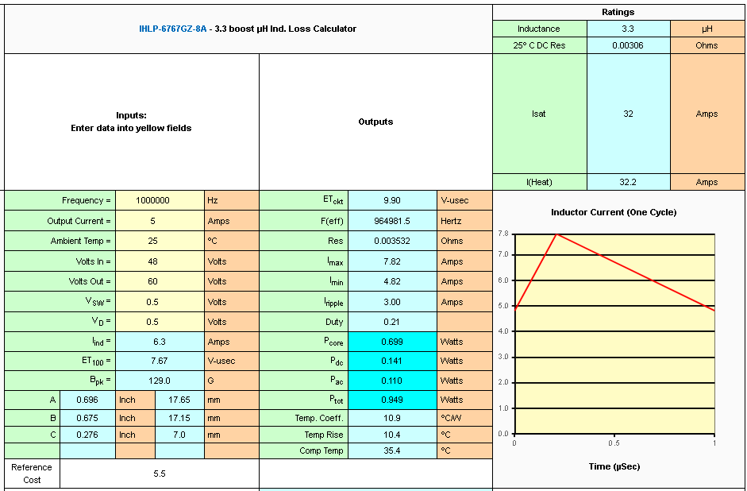
INDUCTOR SELECTION

Slide 9
INDUCTOR SELECTION
Case 2: Inductance selected 3.3uH
By selecting lower value of inductance, loss in inductor becomes 0.949 watts.
Pros:
Reach faster at steady state level than 47uH
Less power loss than 47uH
Cons:
Ripple in inductor more
More noise at transient time
High Peak current

Slide 10
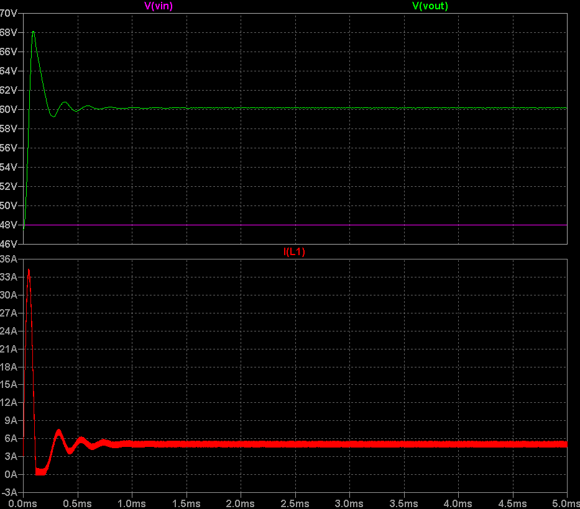
INDUCTOR SELECTION
Case 3: Inductance selected 10uH

Slide 11
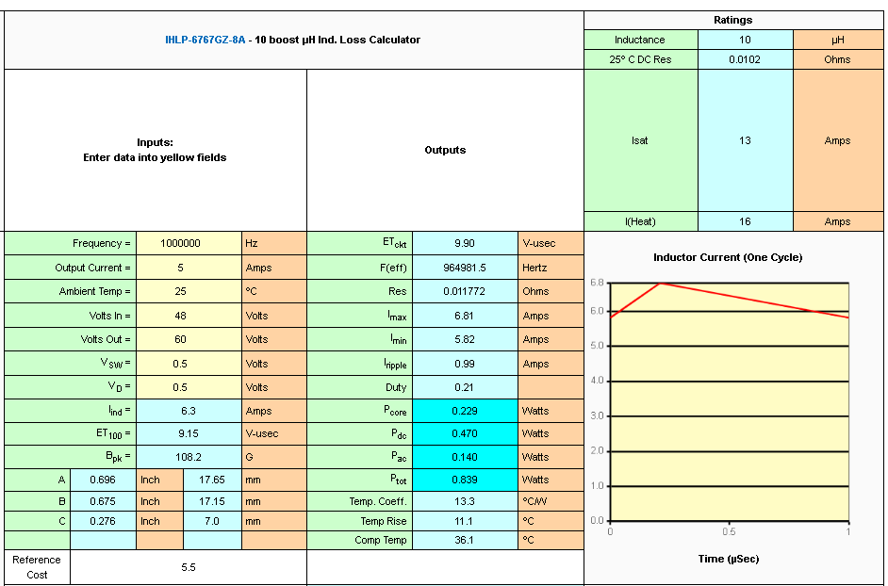
INDUCTOR SELECTION

Slide 12
INDUCTOR SELECTION
Case 3: Inductance selected 10uH
By selecting calculated value of inductance, loss in inductor becomes 0.843 watts.
Pros:
Reach faster at steady state level than 47uH
Ripple is less than 3.3uH inductor
Less power loss among all
Highest efficiency of good among all
Cons:
Ripple in inductor more than 47uH
High Peak current than 47uH but maximum peak current is satisfied

Slide 13
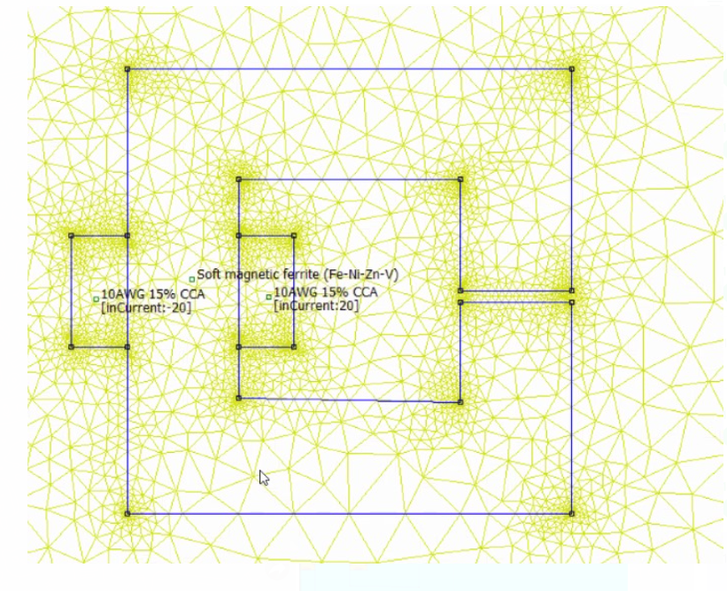
BASIC INDUCTOR:1

Slide 14
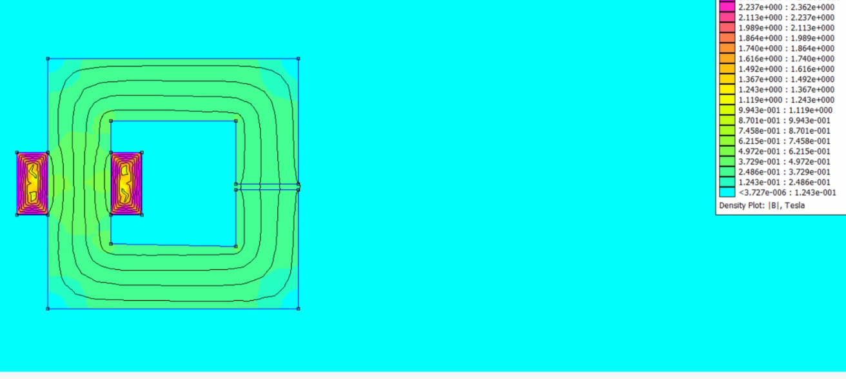
BASIC INDUCTOR:1 (FEMM)

Slide 15
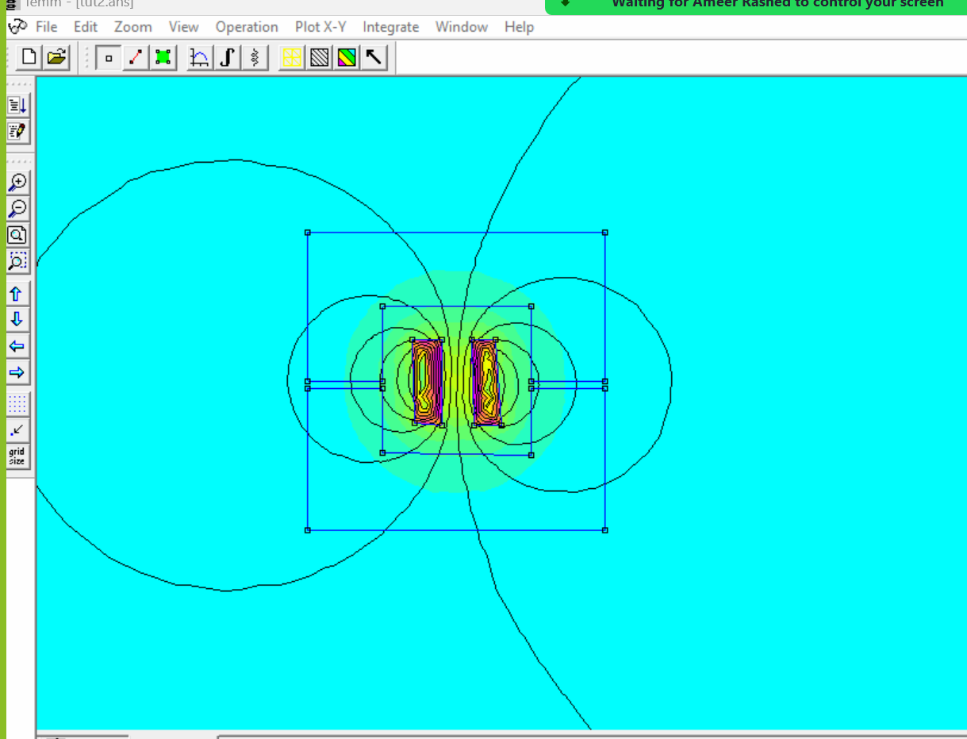
BASIC INDUCTOR: 2

Slide 16
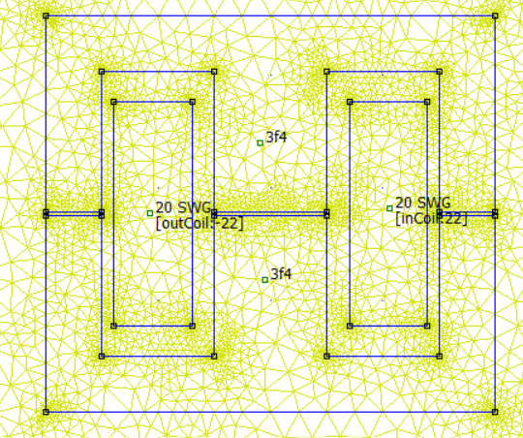
DOUBLE E INDUCTOR (FEMM)
Notes:
Pros:
High Magnetic Efficiency: The double E core design provides a closed magnetic path, which reduces magnetic losses and improves efficiency.
Compact Size: This design allows for a more compact and lightweight inductor compared to other core shapes.
Low Leakage Inductance: The closed magnetic path minimizes leakage inductance, which is beneficial for high-frequency applications.
Good Thermal Performance: The design helps in better heat dissipation, which is crucial for maintaining performance under high power conditions.

Slide 17
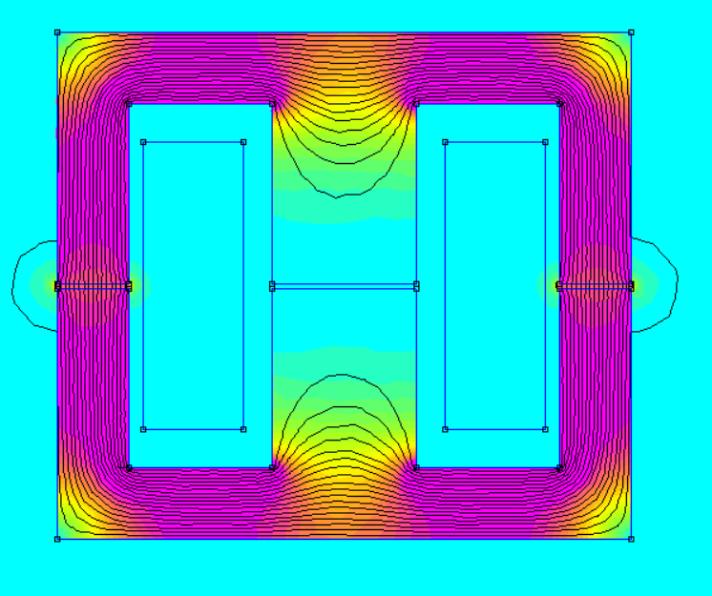
DOUBLE E INDUCTOR (simulation results)

Slide 18
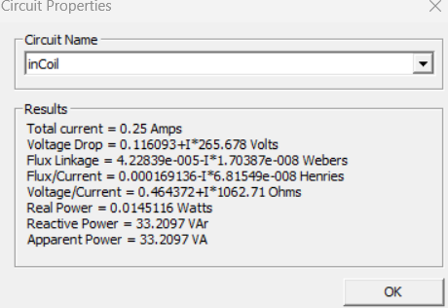
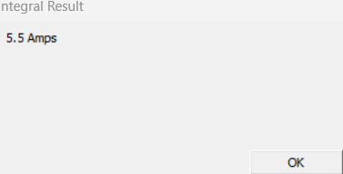
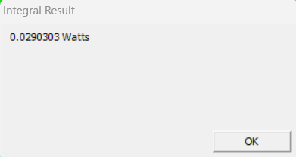
DOUBLE E RESULTS (FEMM)
Total current
Total loss
Winding results

Slide 19
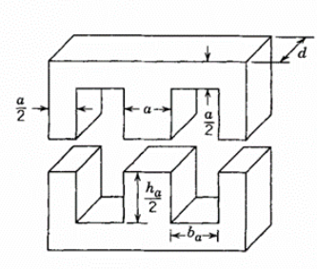
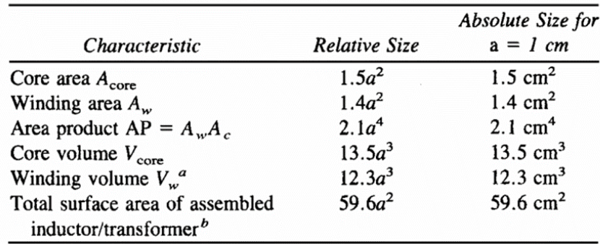
CHOOSING INDUCTOR PROPERTIES: SIZING
d =1.5a , h = 2.5a, b, = 0.7a and h = 2a.
REFRENCE: POWER ELECTRONICS 3rd EDITION , NED MOHAN , TORE

Slide 20
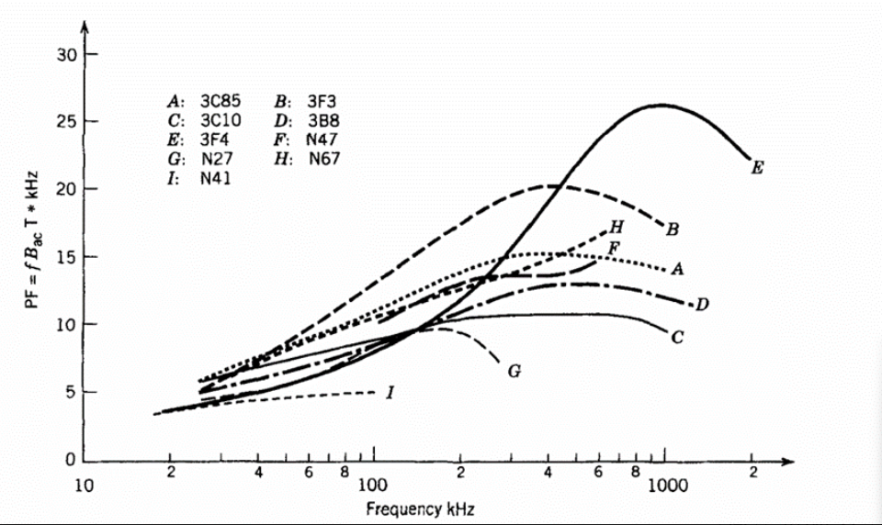
CHOOSING INDUCTOR PROPERTIES: CORE MATERIAL

Slide 21
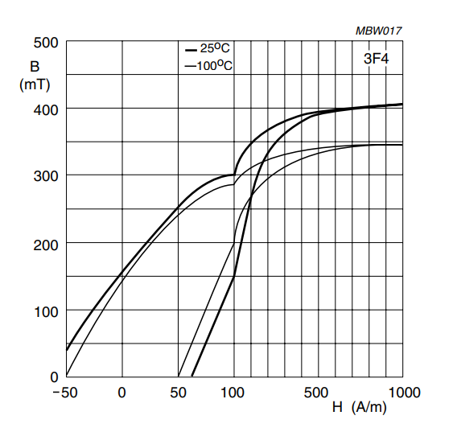
CHOOSING INDUCTOR PROPERTIES: CORE MATERIAL

Slide 22
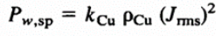
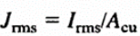
CHOOSING INDUCTOR PROPERTIES: WINDING MATERIAL
Copper was chosen as the winding material due to its high conductivity. Additionally, the flexibility of copper makes winding easier, which reduces the volume of copper needed. This results in a coil with a lower weight. For the thickness of the copper wire, we will choose the thickest possible to minimize wasted power.
Notes:
ניתן לראות שההספק בליפופים תלוי ישירות מ J
ככל שמגדילים A מקטינים J

Slide 23
DOUBLE E CONS
Cons:
Complex Manufacturing: The double E core design can be more complex and costly to manufacture compared to simpler core shapes.
Higher Cost: Due to the complexity and materials used, double E inductors can be more expensive.
Limited Availability: They might not be as readily available as other types of inductors, which can be a limitation for some applications.

Slide 24
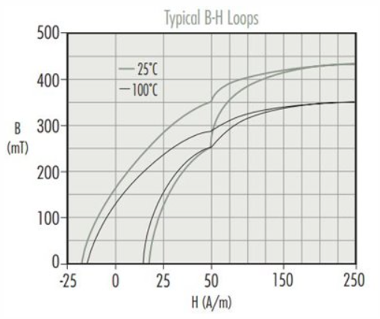
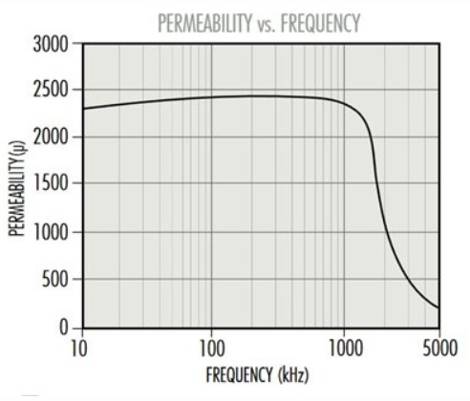
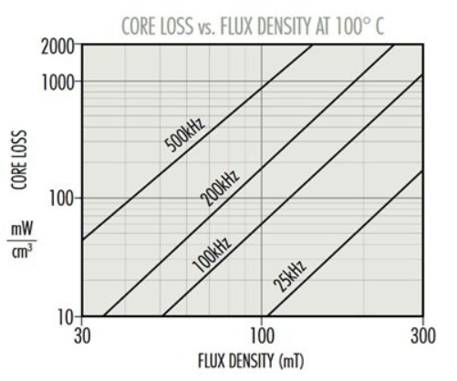
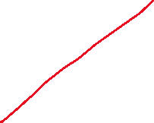
TOROID INDUCTOR: CORE TYPE
Core type: Ferrite core- R type material.
Notes:
R-type material is selected, R-type core material because it has capacity to withstand high frequency
Low Core Losses: R-type cores exhibit minimal core losses, especially at high temperatures (100°C to 110°C), making them efficient for high-frequency applications
High Saturation Flux Density: These materials can handle higher magnetic flux densities without saturating, which is crucial for maintaining performance under heavy loads.
Thermal Stability: R-type cores maintain their performance characteristics over a wide temperature range, ensuring reliability in demanding environments
Consistent Performance: They offer consistent performance, which is essential for applications requiring precise and stable operation.

Slide 25
TOROID INDUCTOR: CORE TYPE
Selected core: 0_43825TC from magnetics manufacture
Current density (J) = 3 A/mm²
Current (I) = 10 A
Area product: (L*I^2)/(B*Kw*Kc*J) = (35.6u*10*10)/(0.02*0.6*1*3*10^6)
= 9.88* 10^-7 cm^4
Inductance: ~35.6uH
Wire Selection: 14 AWG

Slide 26
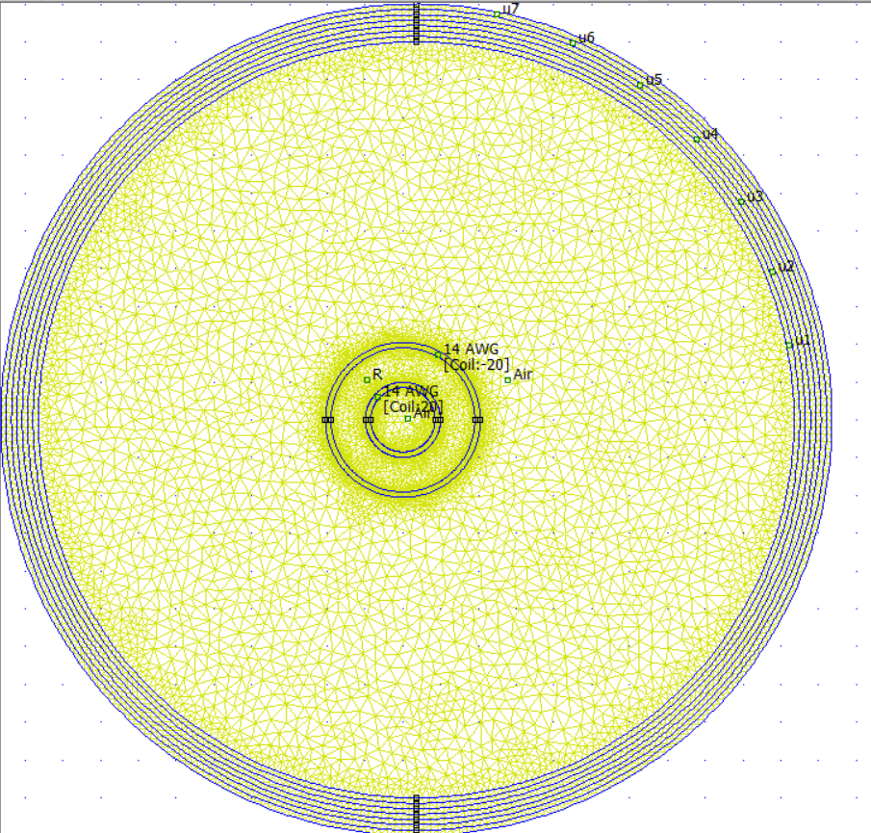
TOROID INDUCTOR: DESING

Slide 27
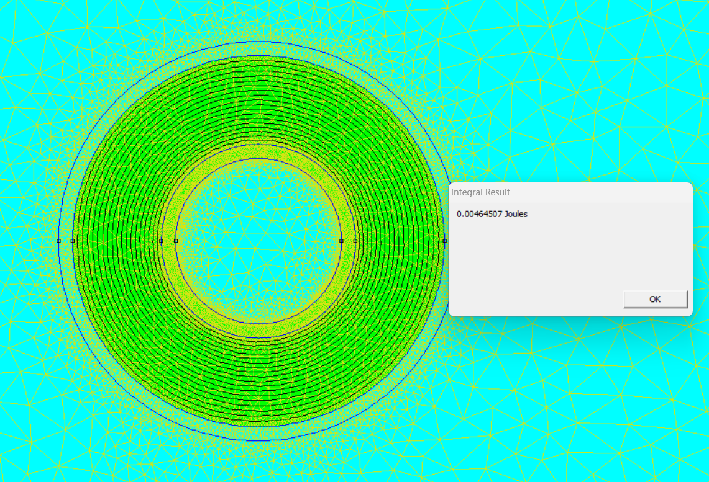
TOROID INDUCTOR: FEMM RESULTS

Slide 28
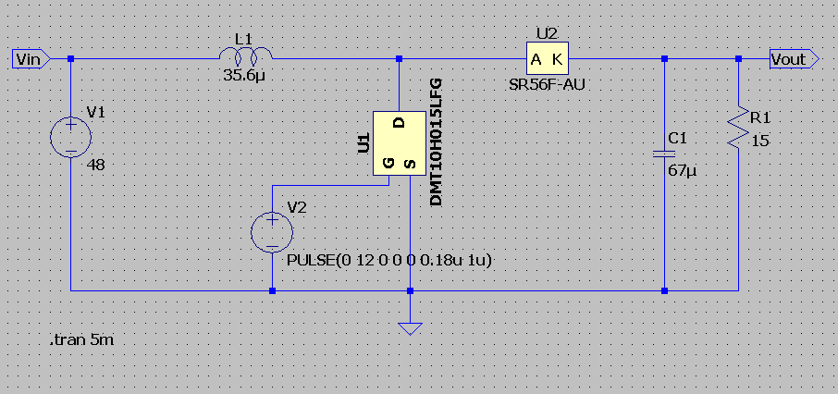
Ideal toroid

Slide 29
Simulating nonlinearity OF toroid
No. | Parameters | Values
1 | AL (inductance) | 8.06 uH/N^2
2 | Le (path length) | 82.8 mm
3 | Ae (cross section) | 231 mm^2
4 | B (flux density) | 0.02 Tesla
5 | H (flux intensity) | 15 A/m
6 | Outer length | 38.1 mm
7 | Inner length | 19 mm
8 | Height | 25.4 mm
9 | N (number of turns) | 20

Slide 30
Python Code to Check Current Vs Inductance Graph
import femm
import numpy as np
import matplotlib.pyplot as plt
femm.openfemm()
femm.opendocument("Inductor design 1MHz.FEM"); #save FEMM file where Python install
femm.mi_saveas("tem.fem") #save into Temporary file
min=1; max=10; step=0.5
Npoints = int((max-min)/step)
I=np.arange (min, max, step, dtype=np.float64)
W=np.arange (min, max, step, dtype=np.float64)
L=np.arange (min, max, step, dtype=np.float64)
print("FEMM Result:")
for k in range (0, Npoints):
femm.mi_modifycircprop("Coil",5,I[k])
femm.mi_analyze()
femm.mi_loadsolution()
femm.mo_selectblock(6.5,6.2) #Select inner winding
femm.mo_selectblock(9.5,17.5) #Select Outer winding
femm.mo_selectblock(9.5,10.5) #Select Core
W[k]=femm.mo_blockintegral(2) #Field Energy
L[k]=2*W[k]/I[k]**2 #Inductance
print(I[k],L[k]) #Print result Current Vs Inductance graph
#Plot Current Vs Inductance graph
plt.figure(1)
plt.plot(I,L*1e3, 'rs--')
plt.grid(True)
plt.ylabel("Inductance (mH")
plt.xlabel("Current (A)")
plt.savefig("L_vs_Current.png",dpi=300)

Slide 31
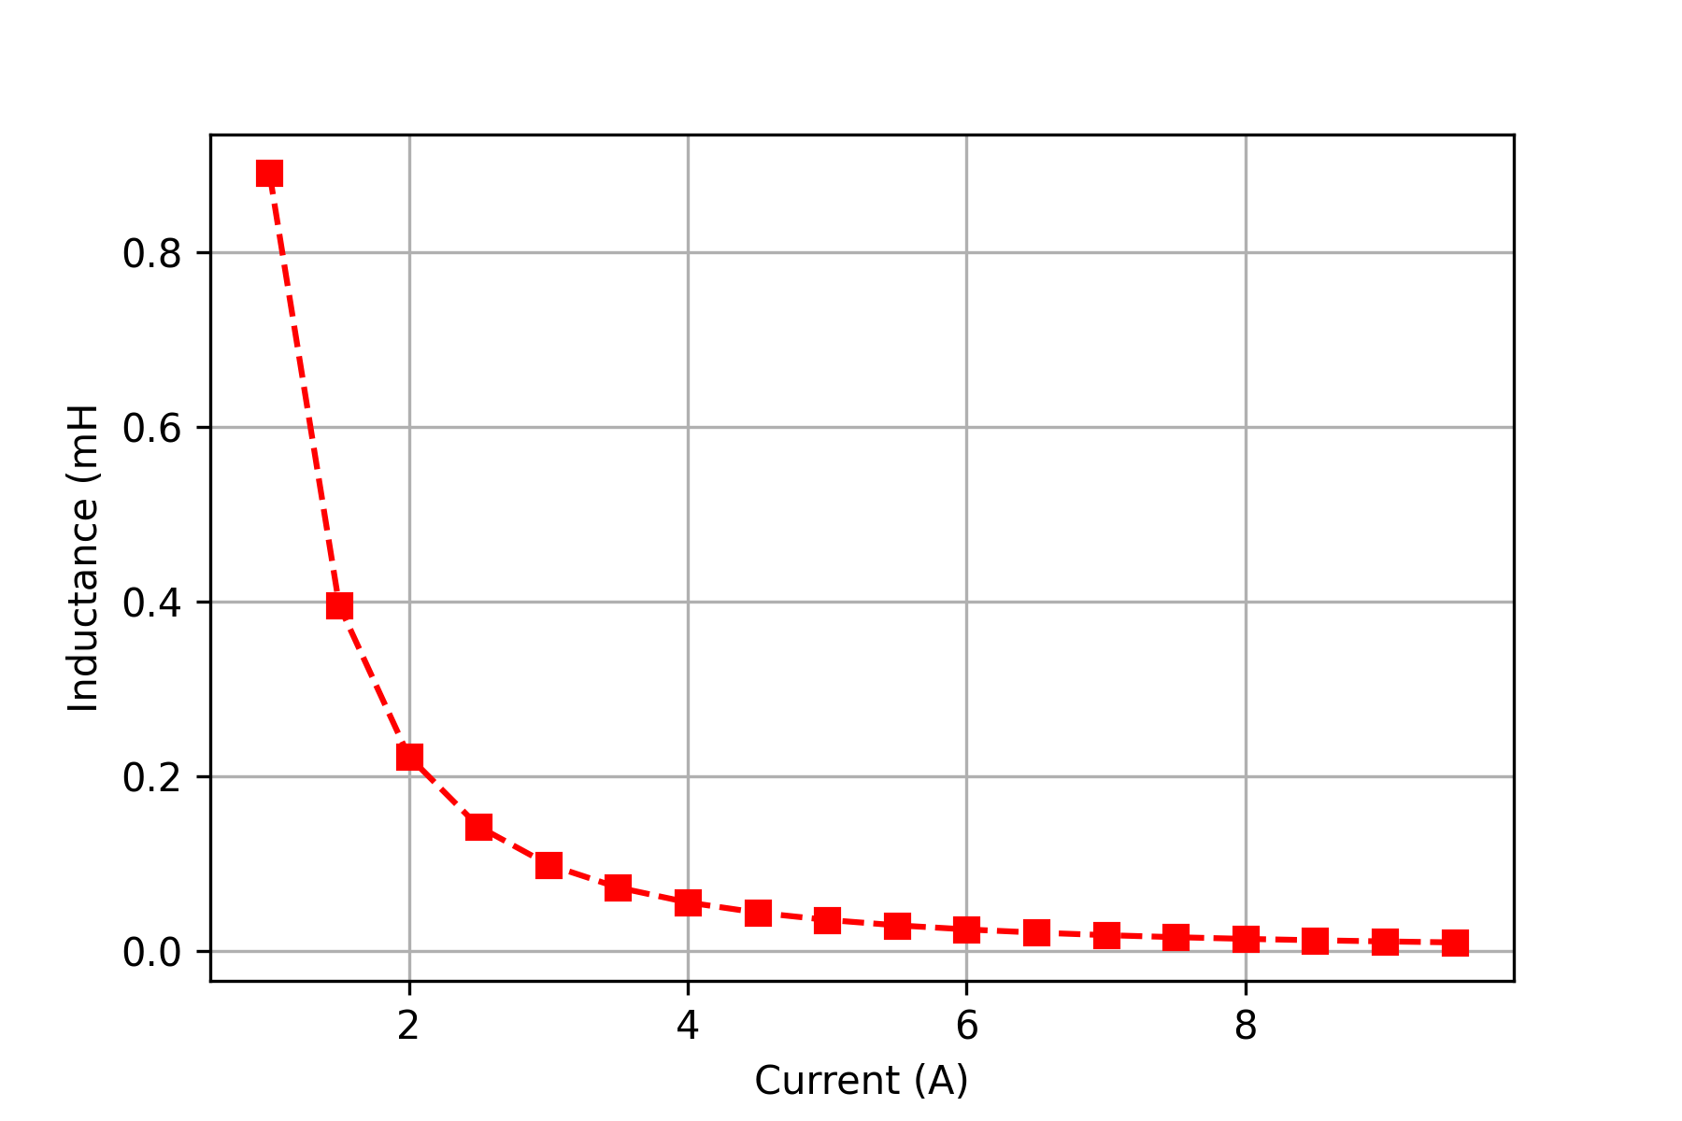
From FEMM to lTspice

Slide 32
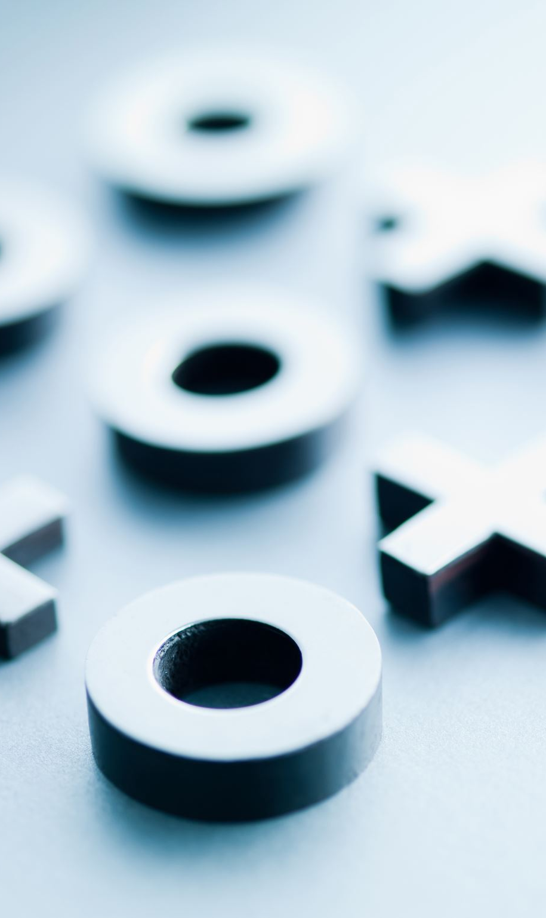
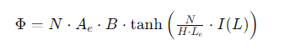
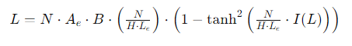
From FEMM to Ltspice
K1 = N*Ae*B ~= 14.6 * 10^-6
K2 = N/(H*Le) = 2.4154
Flux (ɸ)= 14.6 * 10^-6 * tanh (2.4154*I(L))
L = dɸ/dI
Notes:
By using above data derive generates flux from that inductance which means adding nonlinear component of core with it as inductance changes with respect to current demand which shows into LTspice simulation below.

Slide 33
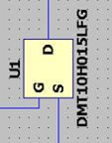
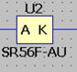
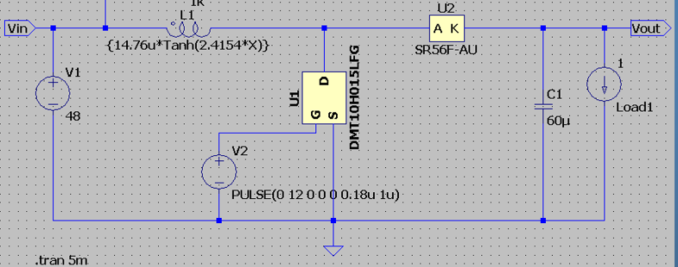
LOW RDS(on)
1.5 milliOHM
Fast Switching Speed
Low Forward Voltage ->מפחית את הפסדי הולכה
Schottky diodes
->fast switching
low reverse leakage current
Thermal Performance

Slide 34
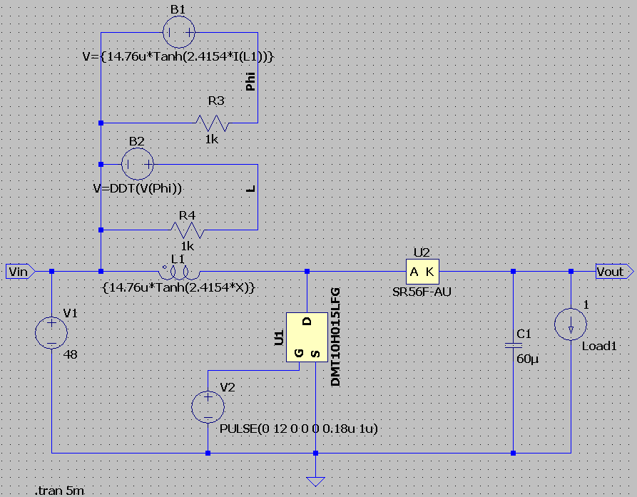

Slide 35
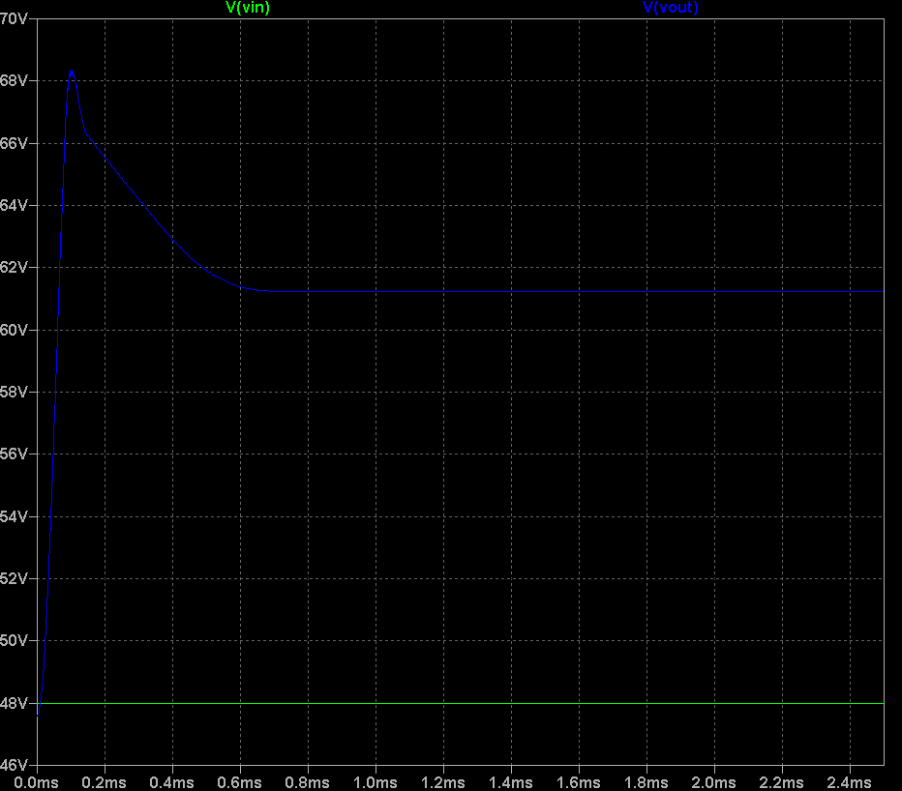
Notes:
Case 1: Load demand is light load (1A). Boost converter deliver ~ 61V. Steady state condition achieve less than 6 msec.

Slide 36
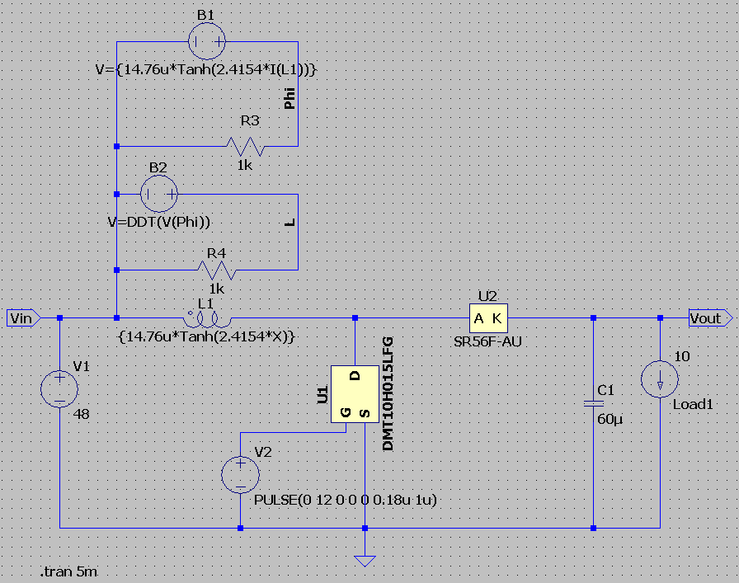

Slide 37
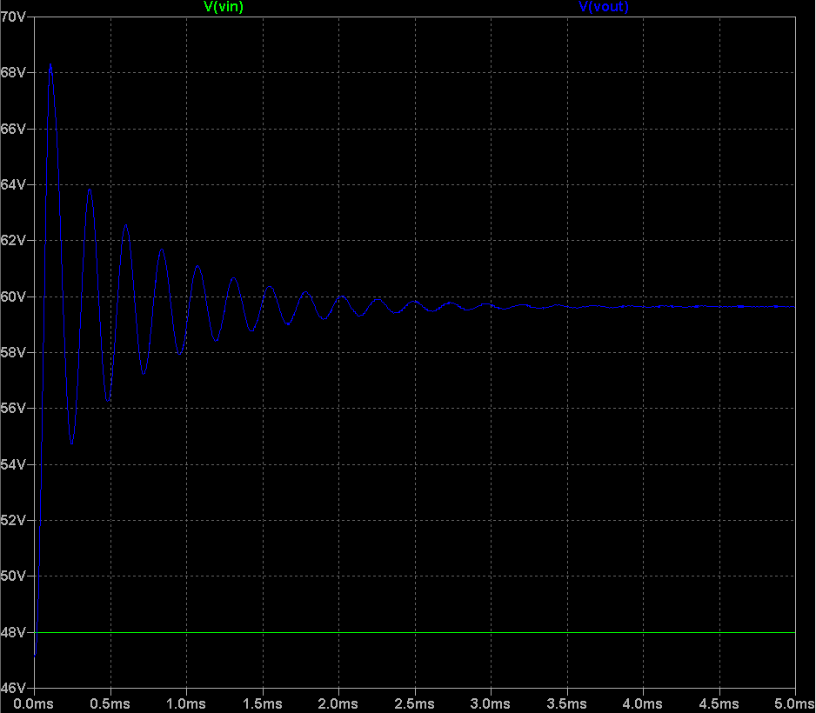
Notes:
Case 2: Load demand is high (10A). Boost converter deliver ~ 59.68V. Steady state condition achieve 3.5 msec i.e. longer time require to be in steady state condition for high load demand.

Slide 38
Thank you!

